Slide 1


P P SAVANI
U N I V E R S I T Y
Handwritten Digit Recognition
Guided by: Ms. Aakash Gupta
(assistant professor)

Slide 2

WORKING BY
Jeel Vaghani-20SE02ML050
Krunal Patel-20SE02ML033
Fenil Patel-20SE02ML032

Slide 3
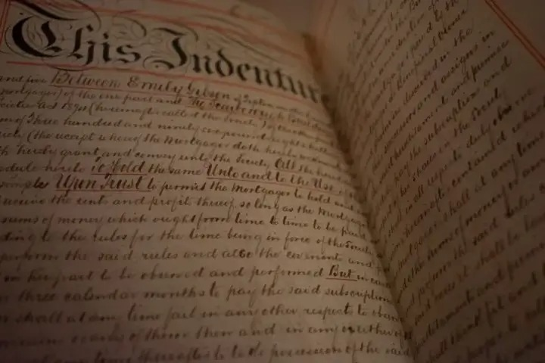
We Want Handwritten Recognition or Not ?
The handwritten digit recognition is the ability of computers to recognize human handwritten digits. It is a hard task for the machine because handwritten digits are not perfect and can be made with many different flavors.

Slide 4
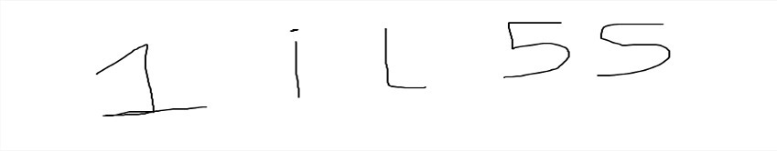
In real life, if a first person handwriting is bad and can't be easily recognized by a second person he will ask the first person about what is written here.
Like such a case below there are few samples of handwritten digits & characters .
A human can recognize all digits & characters easily . but at last 2 digits & characters humans can be confused between 5 and S .
If machines are asked to recognize it will predict the first 3 digits & characters accurately but it will be confused between 5 and S .
By this project we will create a model which will predict digits & characters by giving the Probability value of the digits & characters accurately .

Slide 5

In Which language it will carried out ?
This project can be done in many IDE like google Colab , Jupyter notebook, Anaconda etc.

Slide 6
Flowchart of our Project

Slide 7
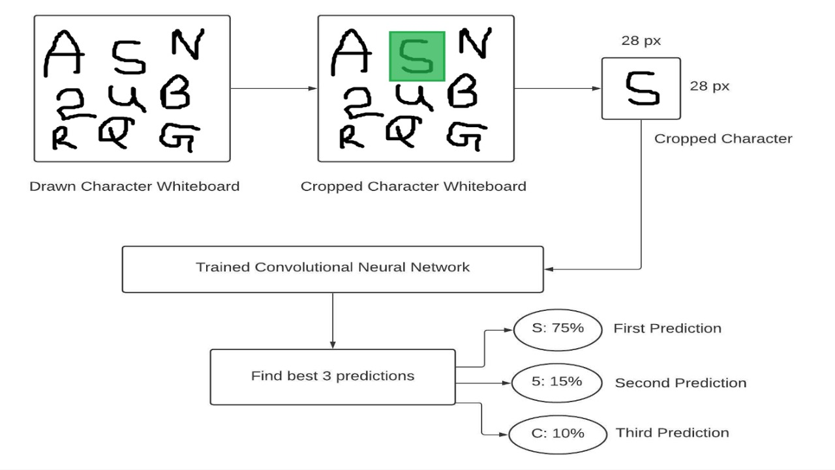

Slide 8
Thank you

